Slide 1
RJC
Housing Presentation
RJC Housing Committee HMDA 2007 - 2017 data review

Slide 2
Introduction
RJC has countless first hand accounts of racially-motivated housing discrimination in the South Bend area, however, the “hard-data” required to back up these claims is lacking. The goal of our work is to analyse HMDA data sets to look for trends and create visualizations that support the widespread discriminatory experience of many community members.
RJC
South Bend Reparatory Justice Commission

Slide 3
OVERVIEW
Committee Meetings + Research
Initial Meetings
Data Collection
Meet with Darryl Heller as well as Professor Judy Fox
Collection of testimonial experiences and outside sources
HMDA public datasets

Slide 4
OVERVIEW
Data Analysis
Visualizations
Used python and excel to clean the raw data
Created some mock visualizations that can be tailored to your specific wants
Modification of Visualizations

Slide 5
Research Methods: Personal Testimonies
Initial meeting with Professor Judy + personal testimonies show: going back as late as the 90s, black people in South Bend have been denied a mortgage because of their race.
This claim was also supported by the findings of The Urban Institute
Research illustrates systemic inequalities through analysis of housing and mortgage data.
Also supported by Consumer Financial Protection Bureau reports (next slide).
The South bend community has expressed concerns about systemic discrimination such as access to housing, education, work/income, etc.
Credit score disparities impacting loan access:
Credit score models disproportionately disadvantaged Black and Hispanic borrowers.
Supported by data from Federal Reserve Studies and the National Bureau of Economic Research (next slide)
Notes:
Urban institute: Ex: 2012, banks were not financing properties under $100,000, however, black people were trying to buy these houses, but could not due to lack of returns from smaller properties
Other claim about credit score: Emily’s Mom used to work as a VP for Discover…

Slide 6
Research Methods: General Research
Nationally, minority groups have been disproportionately denied loans(adjusted for other factors like income, loan amount, etc.)
Consumer Financial Protection Bureau (CFPB) Reports:
Yearly analysis of national HMDA data, consistently shows disproportionally high denial rates for minority groups.
Credit Score on Loan Approval:
Federal Reserve Studies: Black and Hispanic consumers are more likely to have lower credit scores compared to White customers as a result of historical and systemic barriers to wealth accumulation, such as redlining or employment discrimination.
National Bureau of Economic Research (NBER): indicates that these disparities are not necessarily reflective of risk but instead a result of racial disparities (that impact credit score).
Notes:
Historically: minority groups have been disproportionately denied

Slide 7
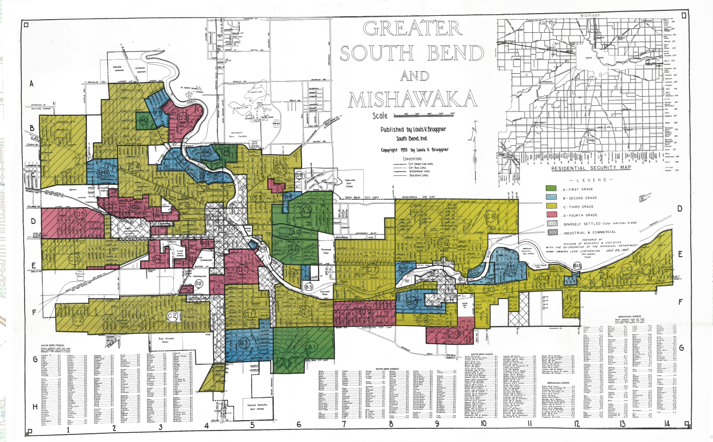
Research Methods: Redlining in South Bend
“LaSalle Park, the primary Black neighborhood, received a D-rating and was located next to Beck's Lake, for decades a dumping ground for toxic industrial waste. Outside of the West Side, Black neighborhoods on Prairie Avenue and Sorin Street similarly received the lowest ratings.” - Mapping Inequality
“The city is implicated because it acquired the property around 1960 and developed Lasalle Park “without awareness of past contamination,” according to a presentation to area residents in March.” - Jordan Smith (South Bend Tribune)
Notes:
Intro about what red lining is
Map -> description of how the city is involved
Low property ownership rates are just one of redlining's lasting effects on urban communities and communities of color.
This data and map helps give good context to what we found

Slide 8
Research Methods: Personal Testimonies
PERSONAL TESTIMONIES
Mapping Inequality from South Bend Tribune
Personal testimonies of redlining from South Bend residents in South Bend Tribune
"The part that we know of as the park now was the swamp area," he recalled. "Actually, it was a landfill where people would come and dump their garbage every week. … I lived on Kenmore Street. The dump started on the other side of our alley. We saw it, heard it, smelled it every day." - Coleman, 68
Notes:
More redlining- this comes from the article called South Bend history of racial redlining. South Bend Tribune also discussed redlining and the implications that follow it: “redlining was a form of lending discrimination in which banks denied mortgages to people of color and ethnic minorities, preventing them from buying homes in certain neighborhoods. This forced families of color into neighborhoods often classified as "hazardous," neighborhoods where little-to-no investment was made in business, infrastructure or opportunity.”

Slide 9
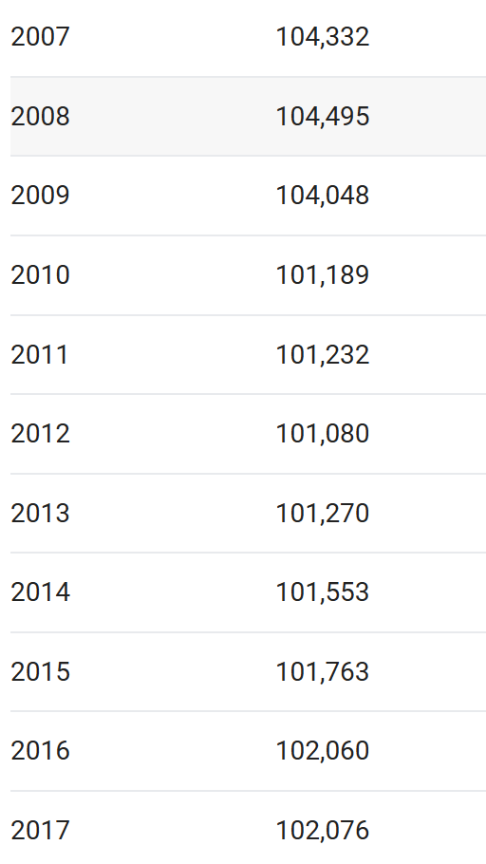
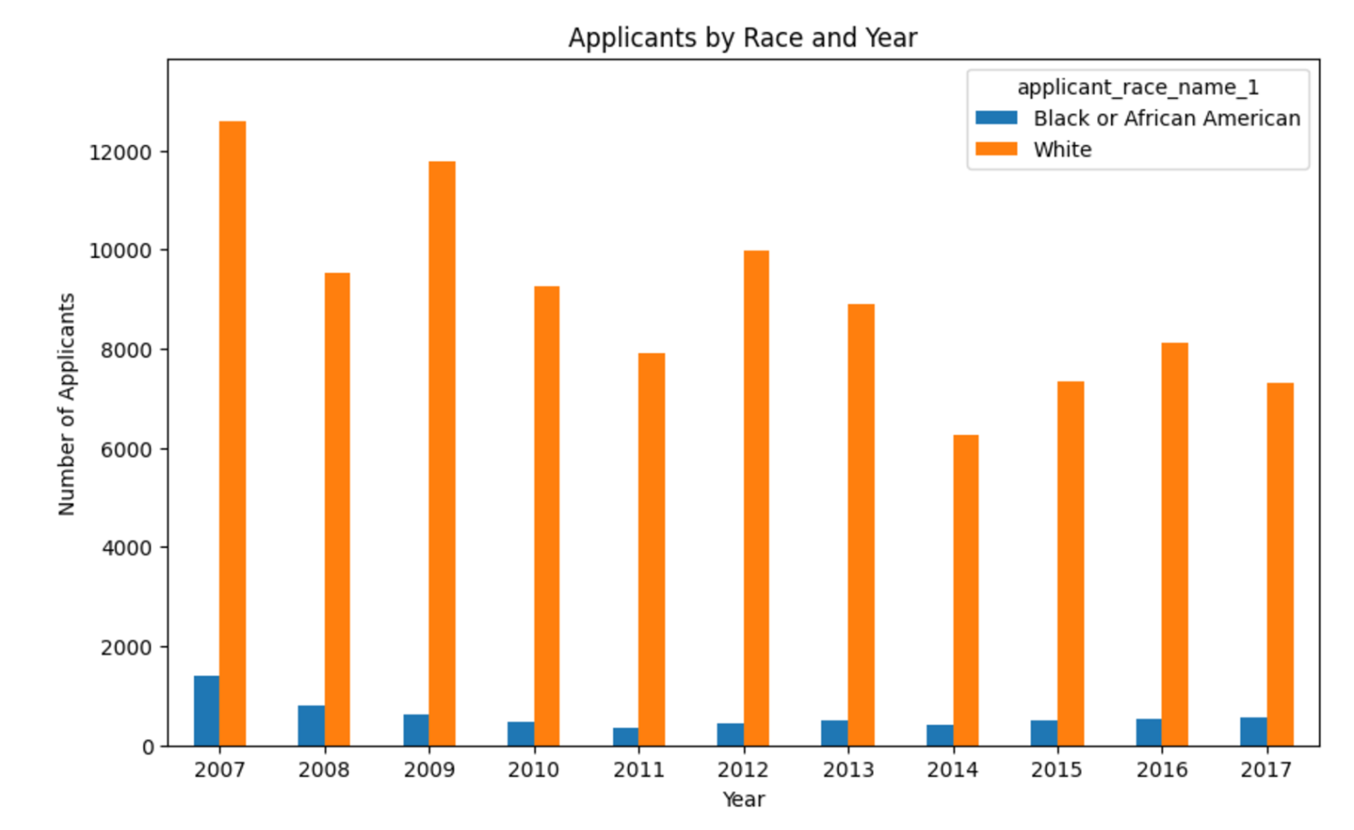
Research Methods: Population Background
Graph representing population applicants per race & year
General South Bend population numbers
Notes:
General population numbers give a background to numbers regarding people applying for loans
We used this information to give context to many of our findings & tweak our graphs and code to allow for better data visualizations
As you can tell it is a small population of sb residents that are applying to loans and it is disproportionately white applicants in comparison to black and african american applicants. This is why it was important to account for this within our graphs, as we then went and normalized the graphs to be adjusted by entries related to these two specific races as without doing so, the accuracy would be greatly skewed and incorrect

Slide 10
DATA
ADVANTAGES & DISADVANTAGES
Collection of financing data from various sources (banks), consequently, some incomplete fields
HMDA
Open-source
ANALYSIS
Done mainly in excel and Google Collaboratory (Python)
RANGE
From 2007-2017. We also created a cumulative HMDA data set for analysis
Notes:
Hmda data was narrowed down to specific area, into msa md codes & state codes to narrow down to south bend, mishawaka data in the hmda data (Metropolitan Statistical Area/Metropolitan Division)
Narrowed to specific columns we found relevant, mainly used applicant race, applicant gender, median income, loan approval and loan denial reason

Slide 11
DATA - Initial Findings
Finding #1
Disproportionate denial of loans for those who identify as Black in comparison to White
Finding #3
Women were more likely to be rejected for loan applications compared to men
Finding #2
For African Americans or Blacks, the median income salary was much lower compared to the entire area
Notes:
Just read the findings here and then make connections/elaborate in each slide I think

Slide 12
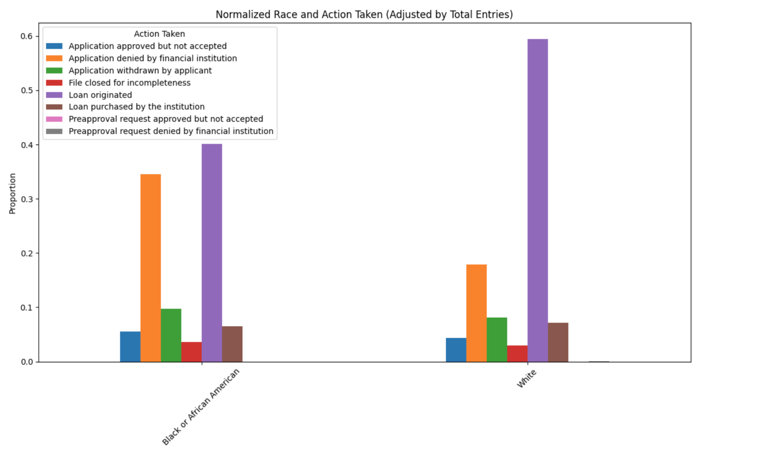
VISUALIZATIONS - Disproportionate Denial
Data averaged from 2007-2017
Notes:
This graph is normalized for population entries to give a better and more accurate representation of denials and loan approvals per race in south bend per year
With information gathered by the committee as well as personal testimonies, this data shows white applicants have a disproportionately higher average of getting a loan originated even with population adjusted
This information can help support the idea that Black or African American applicants are more likely to have their application denied by a financial institution. With the proportion so similar in this this area in comparison to the white applicants
This is not perfect tho, it is normalized and adjusted by total entries per race, this doesn’t account for those who do not have their race as part of their application as well as co applicators
It is also averaged for the 10 year period

Slide 13
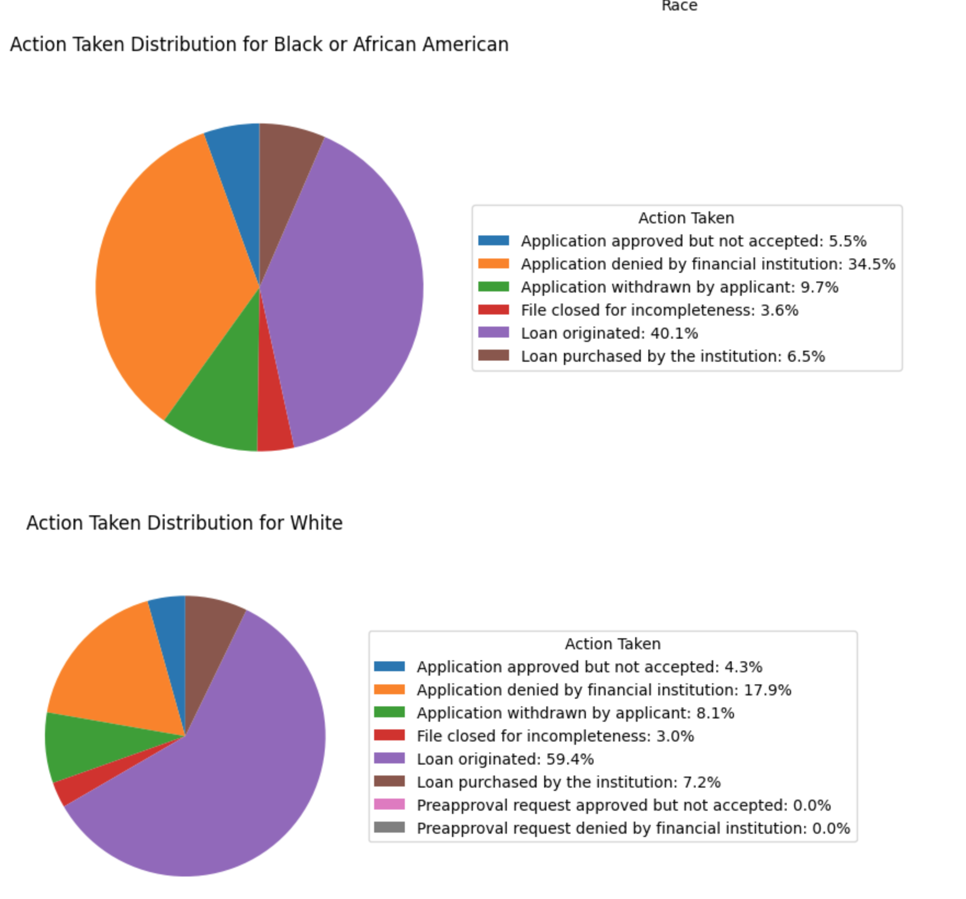
VISUALIZATIONS - Disproportionate Denial
Data averaged from 2007-2017
Notes:
This graph is normalized for population entries to give a better and more accurate representation of denials and loan approvals per race in south bend per year
With information gathered by the committee as well as personal testimonies, this data shows white applicants have a disproportionately higher average of getting a loan originated even with population adjusted
This information can help support the idea that Black or African American applicants are more likely to have their application denied by a financial institution. With the proportion so similar in this this area in comparison to the white applicants
This is not perfect tho, it is normalized and adjusted by total entries per race, this doesn’t account for those who do not have their race as part of their application as well as co applicators
It is also averaged for the 10 year period

Slide 14
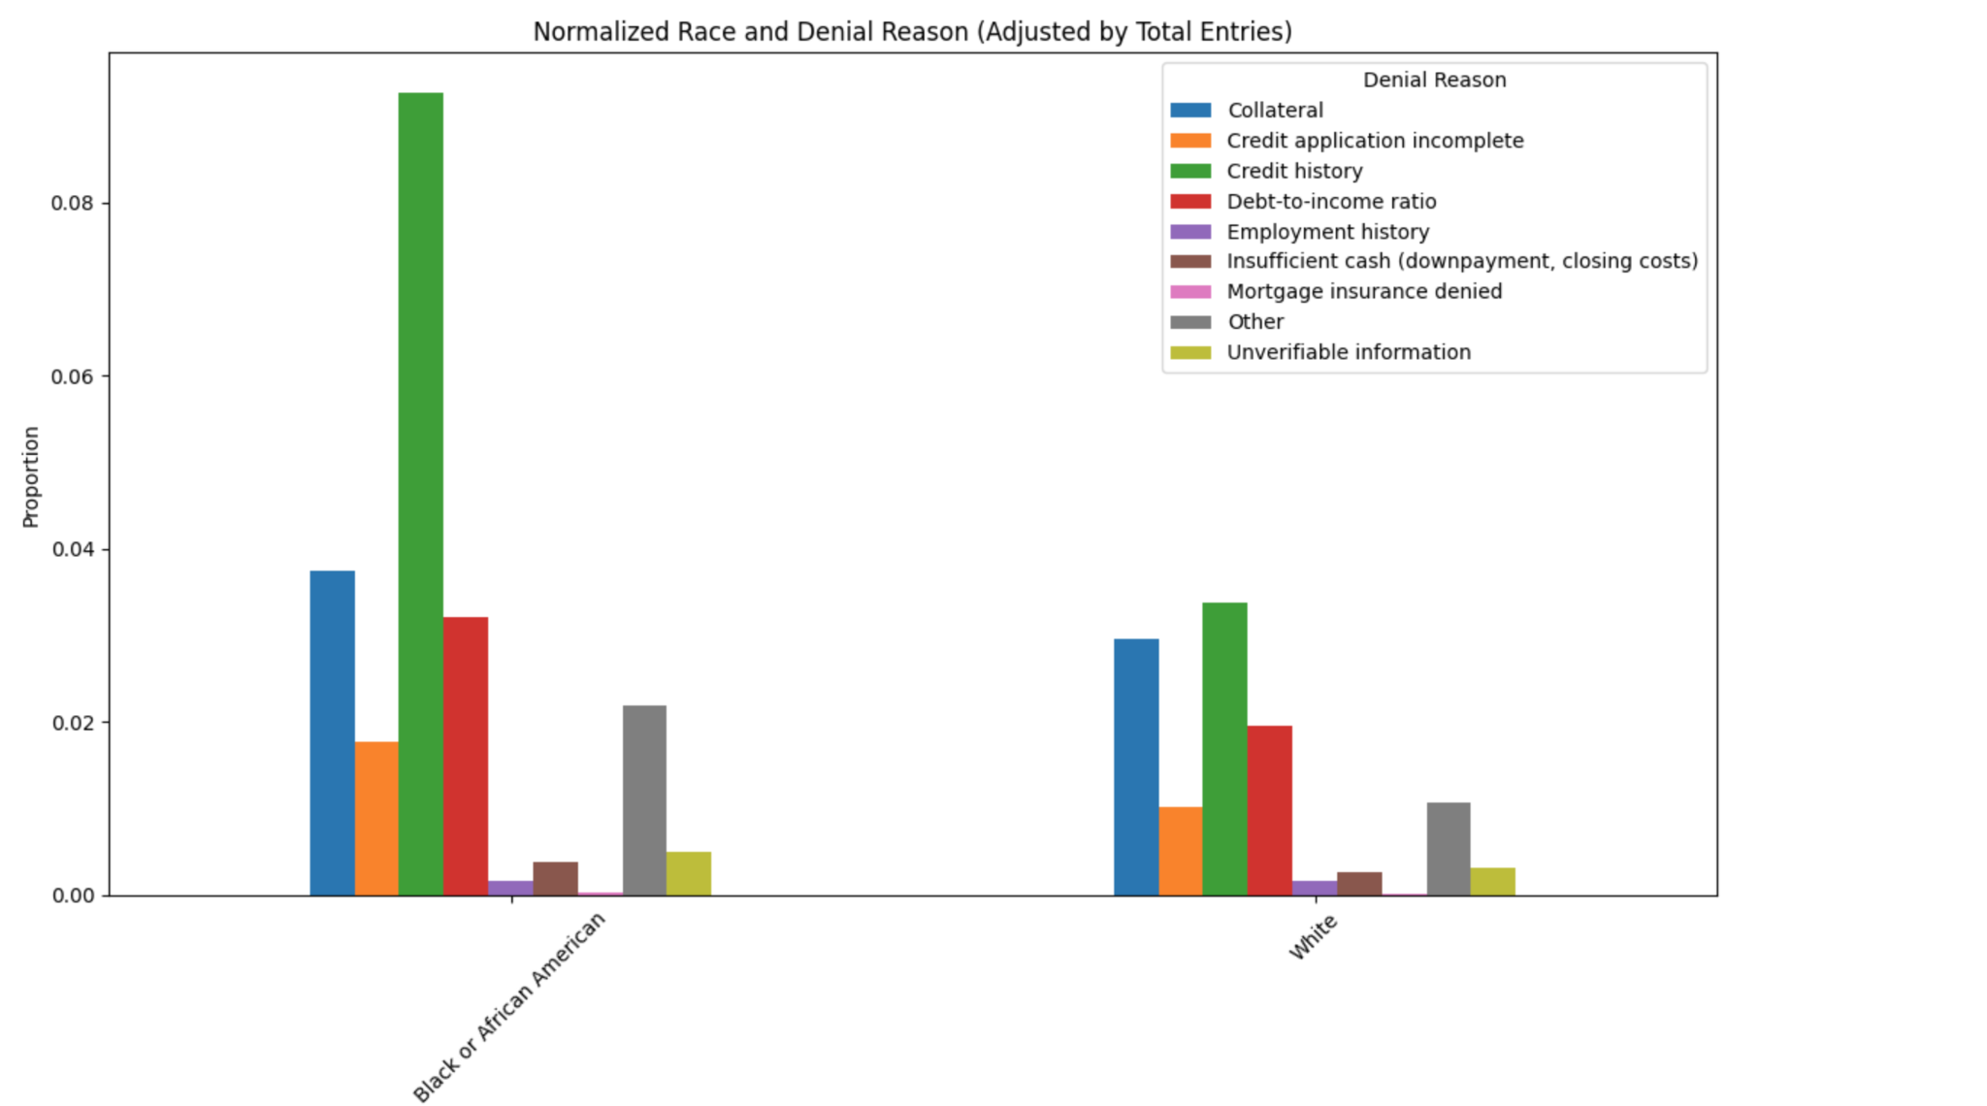
VISUALIZATIONS - Disproportionate Denial
Data averaged from 2007-2017
Notes:
This graph is normalized for population entries to give a better and more accurate representation of denials and loan approvals per race in south bend per year
With information gathered by the committee as well as personal testimonies, this data shows white applicants have a disproportionately higher average of getting a loan originated even with population adjusted
This information can help support the idea that Black or African American applicants are more likely to have their application denied by a financial institution. With the proportion so similar in this this area in comparison to the white applicants
This is not perfect tho, it is normalized and adjusted by total entries per race, this doesn’t account for those who do not have their race as part of their application as well as co applicators
It is also averaged for the 10 year period

Slide 15
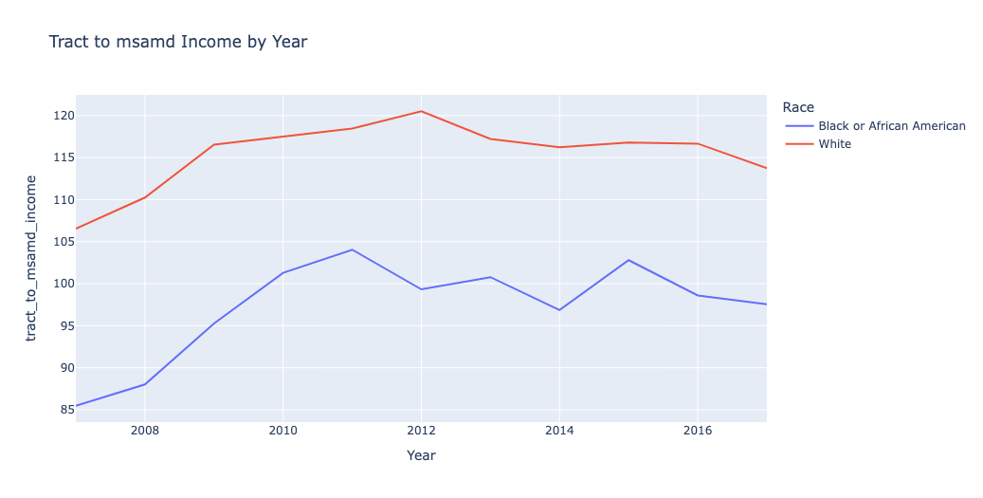
VISUALIZATIONS - Lower Median Income Salary
Notes:
This graph which shows the tract to msamd income by year which is averaged. So, this shows that consistently, it is lower for African Americans.
Finding 2: this tends to create limitations in housing choices. That is, they are less likely to be able to afford similar housing as compared to Whites. This also has implications and suggests why more African Americans or Blacks were forced to live in the LaSalle area???????????????????? (please help reword this- I do not think I have the facts straight with the LaSalle area)

Slide 16
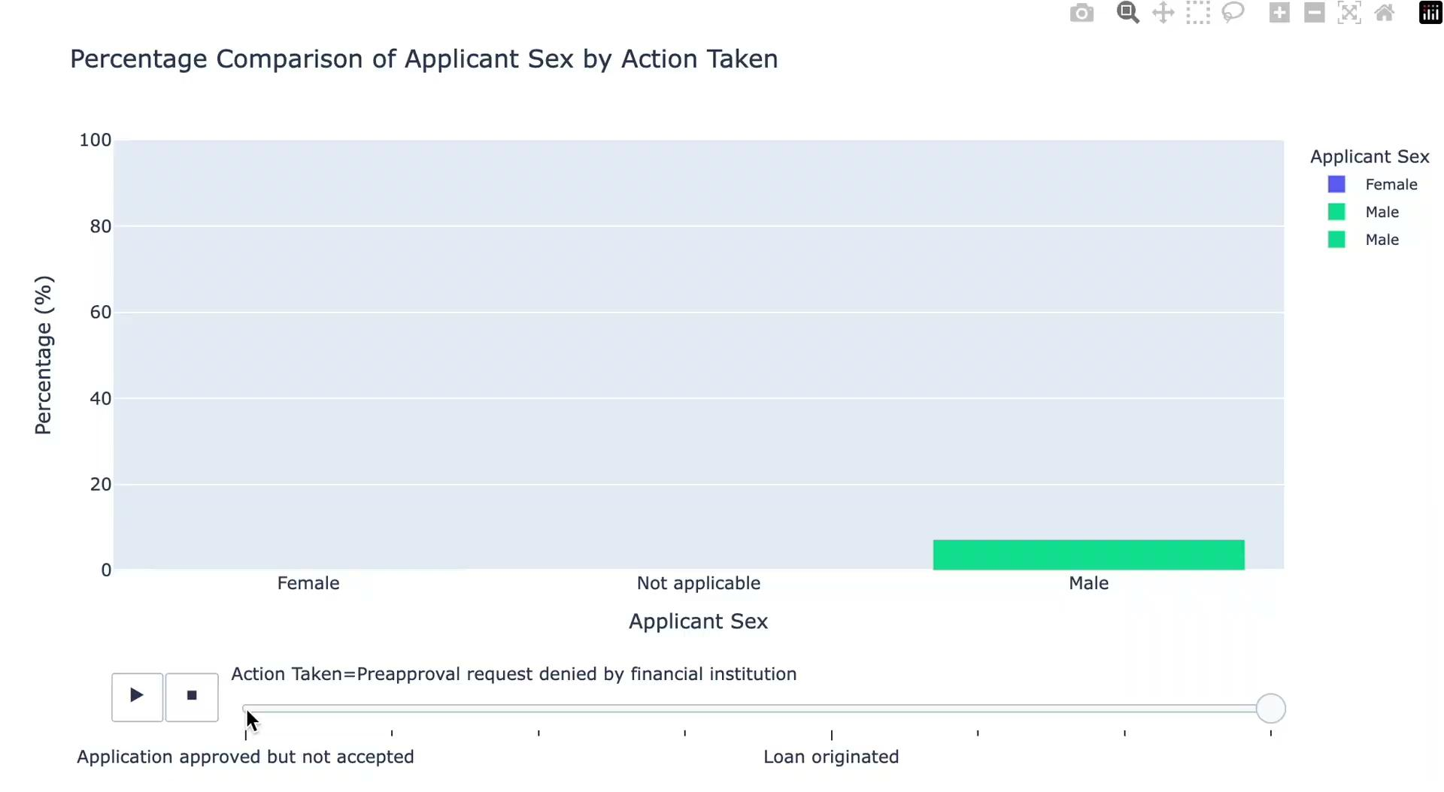
VISUALIZATIONS - Importance of applicant’s sex on loan action
Notes:
Here is an example of interactive graphics to allow users to see how action taken affects the percentage of applicant sex

Slide 17
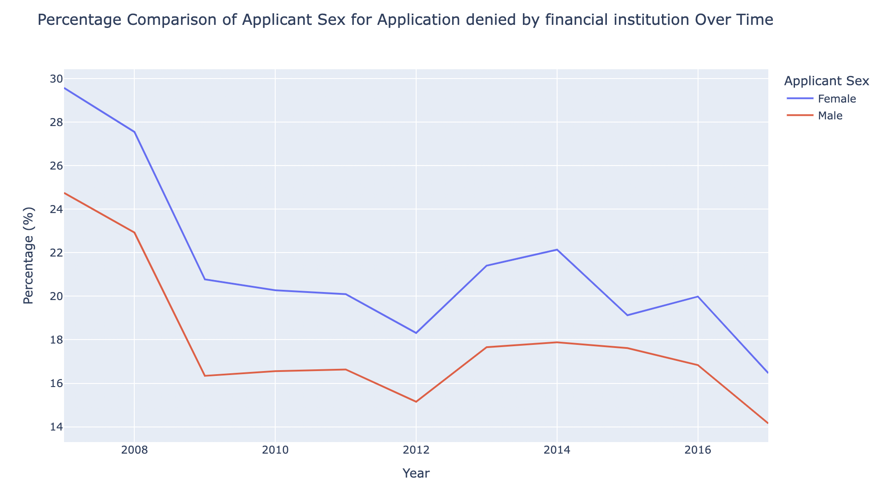
VISUALIZATIONS - Importance of applicant’s sex on loans denied by financial institutions
Throughout the years from 2008 to 2017 it can easily be determined there is an disparity between gender on the amount of loans rejected by a financial institution. The graph shows how 2-5% of women are more likely to have their loans rejected.
In 2007, 29.5% of female loans where rejected while 24.7% of male where rejected
In 2017, 16.4% of female loans where rejected while 14.1% of male where rejected

Slide 18
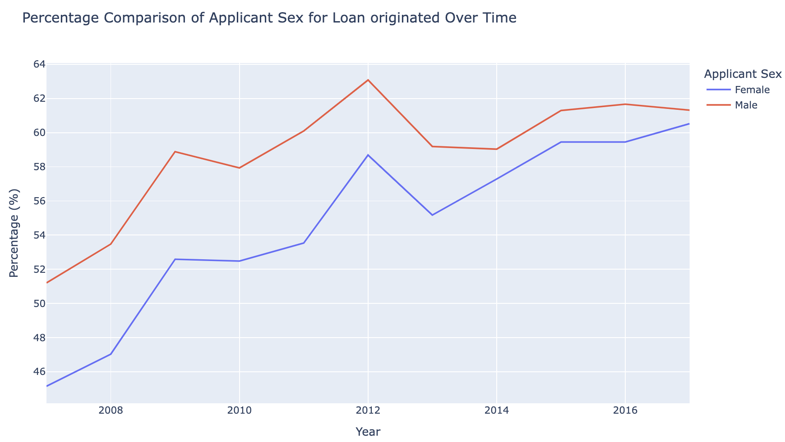
VISUALIZATIONS - Importance of applicant’s sex on loans originated
The disparity of loans originated by applicant sex was around 5% in 2007, however, it had decreased significantly reaching a percentage of difference of only 1.3% on 2017.

Slide 19
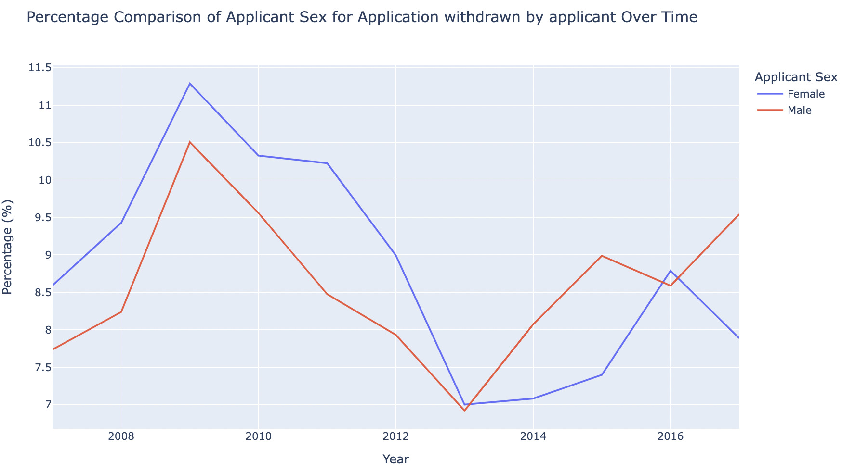
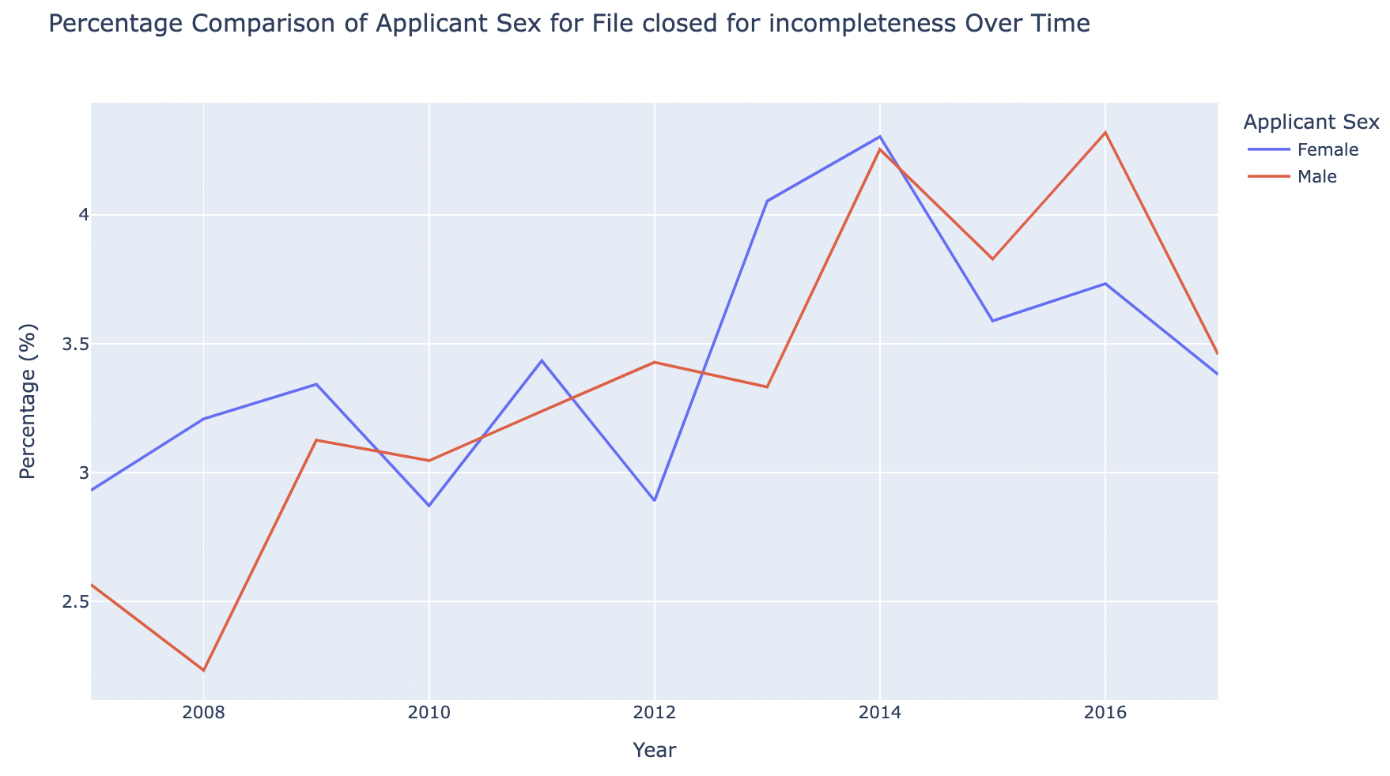
VISUALIZATIONS - Importance of applicant’s sex on loans originated

Slide 20
FUTURE STEPS
Any questions, comments or concerns? It there anything specific that we are missing? How would you like the visualizations to be modified/altered/re-created?

Slide 21
THANKS
Please do not hesitate to reach out if any questions arise.
Hannah Huston: hhuston@nd.edu
Mariam Jafri: mjafri@nd.edu
Emily Manfred: emanfre2@nd.edu
Manuela Roca Zapata: mrocazap@nd.edu
Elizabeth Rhee: erhee@nd.edu

Slide 22
Sources
https://www.neilsberg.com/insights/south-bend-in-population-by-year/
https://www.consumerfinance.gov/data-research/hmda/historic-data/
https://dsl.richmond.edu/panorama/redlining/map/IN/SouthBend/context#loc=12/41.6723/-86.2088
https://www.southbendtribune.com/story/news/local/2022/04/04/south-bend-racism-honeywell-remediate-lasalle-park-black-community-environment-landfill/7216689001/ (more about Beck’s Lake)
https://www.urban.org/policy-centers/housing-finance-policy-center/projects/home-mortgage-disclosure-act-data
https://files.consumerfinance.gov/f/documents/cfpb_racial-economic-disparities-in-mortgage-market_slides_2021-08.pdf
https://files.consumerfinance.gov/f/documents/cfpb_fair-lending-report_2023-06.pdf
https://www.federalreserve.gov/econres/notes/feds-notes/disparities-in-wealth-by-race-and-ethnicity-in-the-2019-survey-of-consumer-finances-20200928.html
https://www.americanprogress.org/article/systematic-inequality/
https://www.nber.org/system/files/working_papers/w29364/w29364.pdf
https://www.nber.org/system/files/working_papers/w32917/w32917.pdf
https://www.southbendtribune.com/story/news/2022/12/12/south-bend-history-of-racial-redlining-explored-in-residents-stories/69695265007/ (personal testimony about redlining and LaSalle area)

